Slide 1


Getting Started with React
Day 2: Components, State, and Navigation
6-HOUR INTENSIVE BOOTCAMP

Slide 2

Learning Goals
By the end of today, you will be able to build, style, and navigate modular React applications using modern best practices.

Slide 3






Core Learning Roadmap
Foundations
Reactivity
Navigation
Understand components, props, and the power of JSX for reusable UI.
Master the useState and useEffect hooks to handle data and side effects.
Implement routing and context to share state across complex apps.

Slide 4

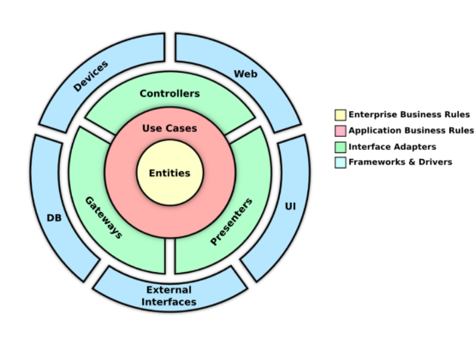

Understanding Components
What is a Component?
A component is an independent, reusable piece of UI. It allows you to split the UI into separate parts and think about each piece in isolation.
Components can be used anywhere in your application, just like custom HTML tags.

Slide 5



JSX: JavaScript + HTML
The JSX Concept
Key Rules
JSX is a syntax extension that looks like HTML but works inside JavaScript. It makes writing UI much more intuitive.
Expressions must be wrapped in curly braces {}. Every JSX element must return a single root tag or a Fragment <>.
Use className instead of class for styling attributes.

Slide 6

Props: Passing Data
Sending Data Downwards
1-WAY
Props (short for properties) are how we pass information from a Parent component to a Child component.
Data Flow Direction
This makes components highly reusable and customizable.

Slide 7




State Management: useState
The useState Hook
Handling Forms
State is "memory" for a component. It stores data that changes over time, like counters or user input.
We use state to track input changes in real-time. This is called a "controlled component."

Slide 8
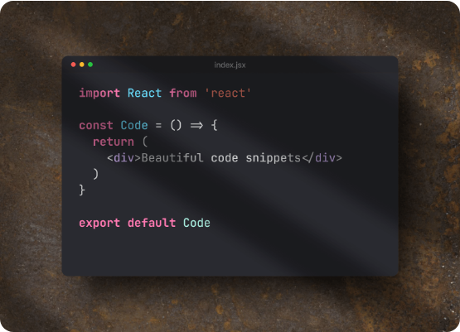
Side Effects: useEffect
Data Fetching: Pull information from external APIs.
Mounting: Run code as soon as the component loads.
Execution: useEffect(() => { ... }, []) runs once.
It allows you to perform side effects in functional components that don't belong in the rendering logic.

Slide 9
Styling the Modern Web
Styling Method | Standard CSS | Tailwind CSS
Syntax | Separate .css files | Utility classes in JSX
Customization | Highly manual | Pre-defined design system
Example | className="title" | className="text-2xl font-bold"
Best For | Legacy or strictly unique designs | Rapid, consistent development

Slide 10




Page Navigation Flow
Implement Multi-Page behavior using react-router-dom.
Define
Install
Setup
Navigate
Route path="/" & component
npm install react-router-dom
BrowserRouter & Routes
Use Link component

Slide 11
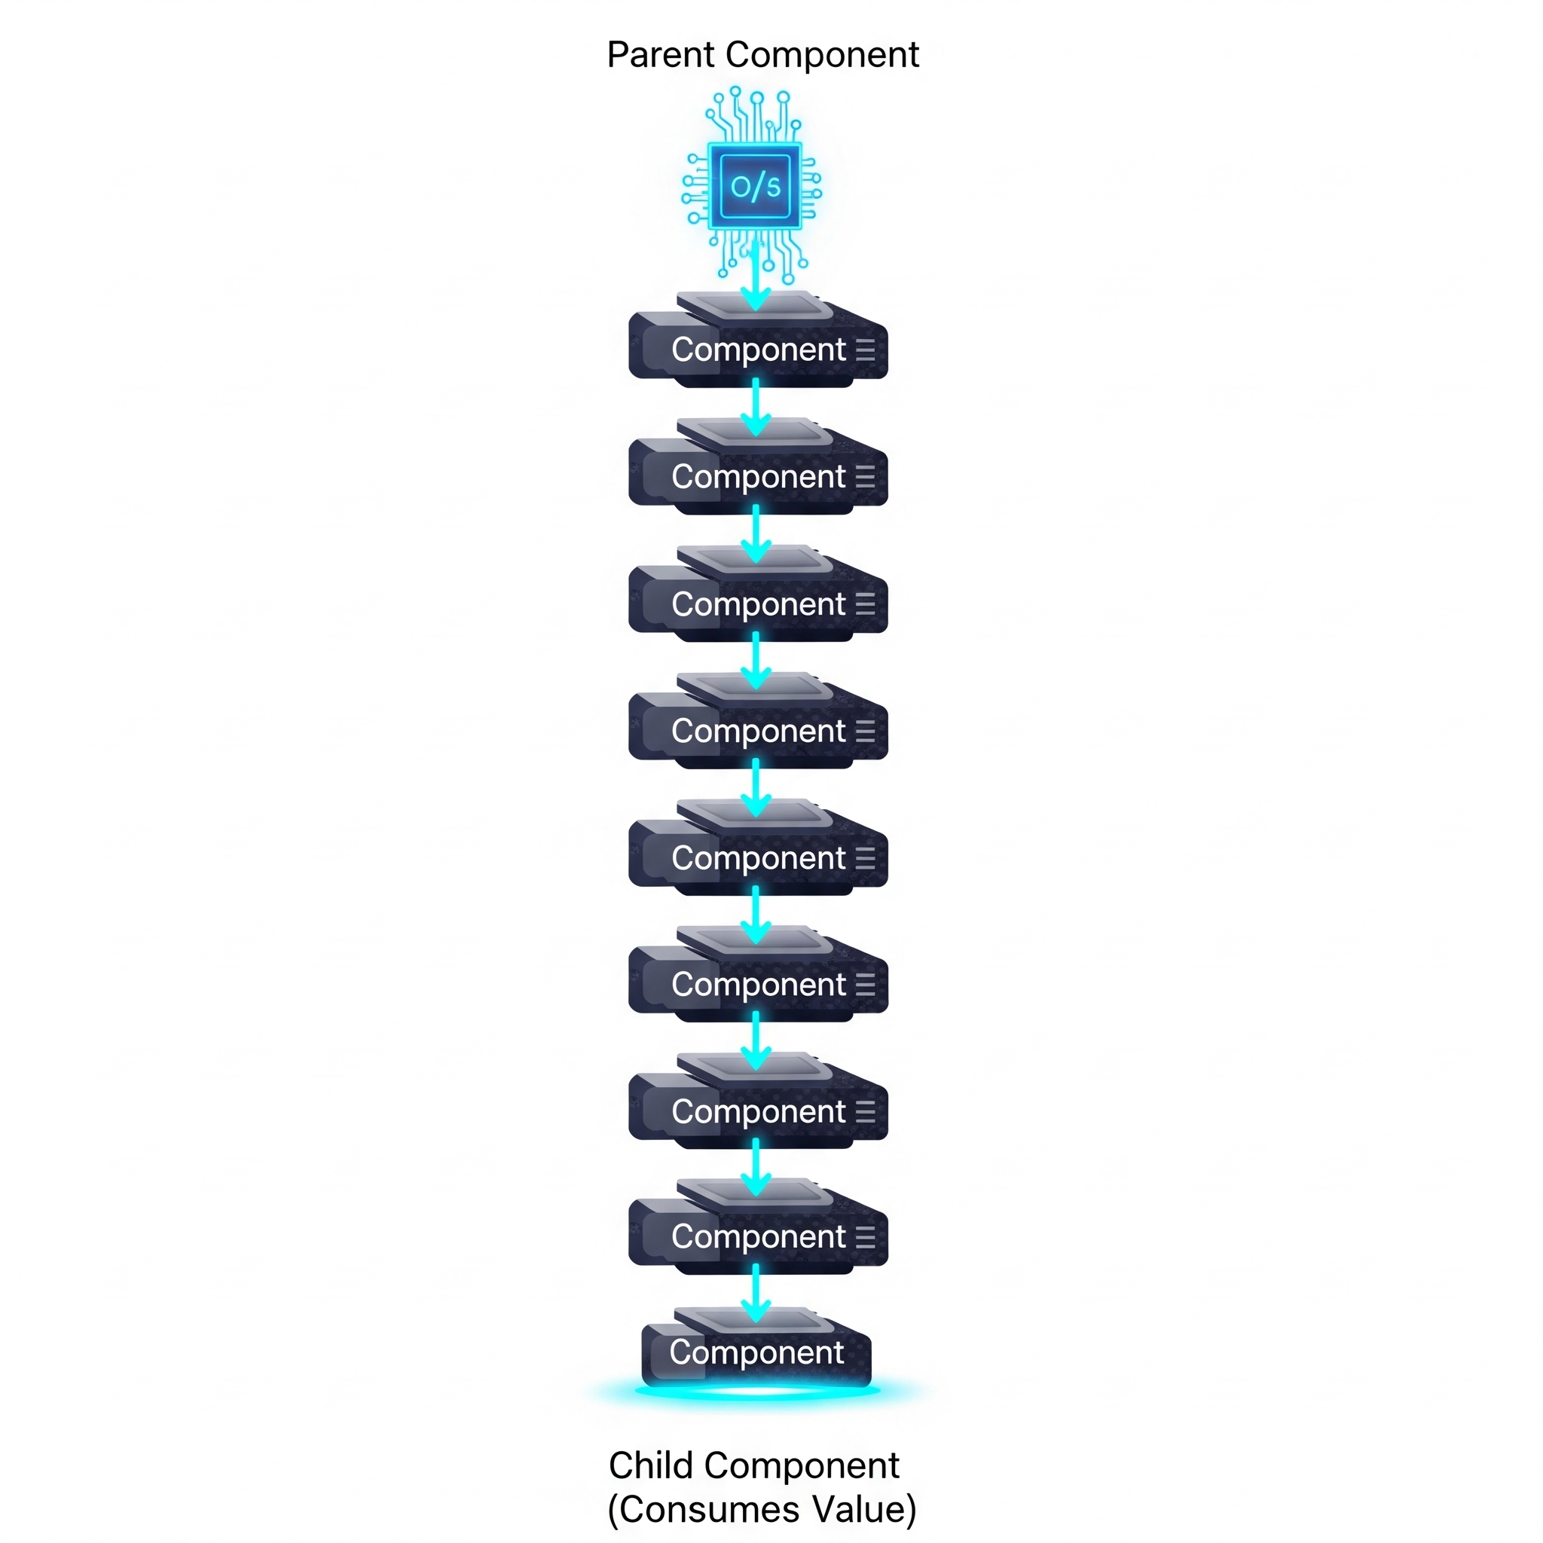

State Sharing: useContext
Avoid Prop Drilling
Context provides a way to pass data through the component tree without having to pass props down manually at every level.
Ideal for themes, user auth, and global settings.

Slide 12
Questions?
Ready to build your first React app!
help@reactbootcamp.io
docs.reactjs.org

